Slide 1

Improving Customer Retention through Churn Analysis
A Presentation for the CMO of Telecom. Company
Presenter: Anh Bui

Slide 2
TALBE OF CONTENTS
Introduction
Context
Business Understanding
Data Information
Cleaning data
Finding Hypothesis Problems
Data Analysis
Data Analysis
Findings
Recommendation
Key Recommendations
Specific recommendations
Conclusion
Summary
Next Steps
Questions?

Slide 3
01
INTRODUCTION

Slide 4
CONTEXT
Telecom. Company, a California-based Telecommunications company is facing a significant churn problem.
This presentation will outline a churn analysis process that can help Telecom. Company identify high-value customers and churn risks, and develop strategies to improve retention.

Slide 5
CONTEXT
Analysis Goals:
Identify high-value customers
Identify customers at risk of churning
Develop strategies to reduce churn and improve customer retention

Slide 6
BUSINESS MODEL CANVAS
Key Partnerships
Equipment manufacturers
Content providers
Other telecommunications companies
Key Activities
Providing telecommunication services
Marketing and sales
Customer service
Value Propositions
Reliable and affordable telecommunication services
A wide range of services, including phone, internet, TV, and mobile
Excellent customer service
Customer Relationships
Personal relationships with customers
Loyalty programs
24/7 customer support
Customer Segments
Residential customers
Business customers
Key Resources
Telecommunications network
Customer relationship management (CRM) system
Billing system
Channels
Retail stores
Online sales
Call center
Mobile app
Cost Structure
Network maintenance costs
Customer acquisition costs
Customer service costs
Revenue Streams
Monthly subscription fees
Pay-per-use fees
Equipment sales
Notes:
The dataset can be used to improve the business model by:
Segmenting customers: The dataset can be used to segment customers into different groups based on their demographics, usage patterns, and other factors. This information can then be used to develop targeted marketing and retention strategies for each group.
Identifying high-value customers: The dataset can be used to identify high-value customers who are more likely to churn. These customers can then be targeted with special offers and loyalty programs to encourage them to stay with the company.
Reducing churn: The dataset can be used to identify the reasons why customers are churning and develop strategies to address these issues. For example, if customers are churning because they are dissatisfied with the price, the company may want to offer them a discount or a new plan with a better value.

Slide 7
DATA INFORMATION
Dataset: Telecom Customer Dataset
Customer demographics (age, gender, marital status, number of dependents, city, zip code, latitude, longitude)
Customer usage patterns (phone service, multiple lines, internet service, internet type, average monthly GB download, online security, online backup, device protection plan, premium tech support, streaming TV, streaming movies, streaming music, unlimited data)
Customer subscription information (contract type, paperless billing, payment method)
Customer financial data (monthly charge, total charges, total refunds, total extra data charges, total long distance charges, total revenue)
Customer status (churned, stayed, joined)
Churn reason (attitude, competitor, dissatisfaction, other, price)
Zip code population
Notes:
As the brief was centred around defining high value and churn risk, I was thinking of ways to analyse just those two aspects. However, the data is not that straight forward. It contains information on age, tenure, services, costs, marital status, location, etc.

Slide 8
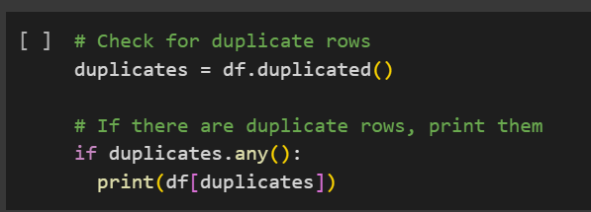
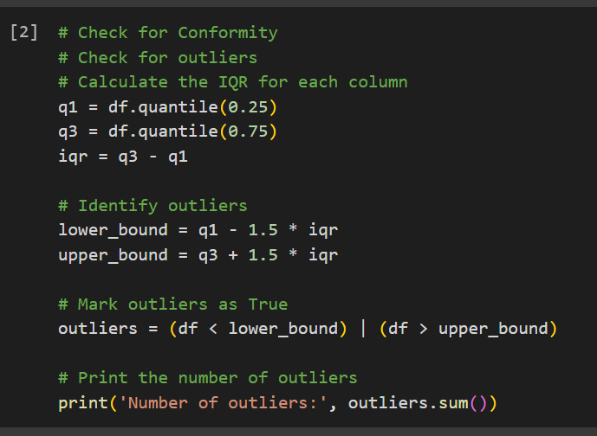
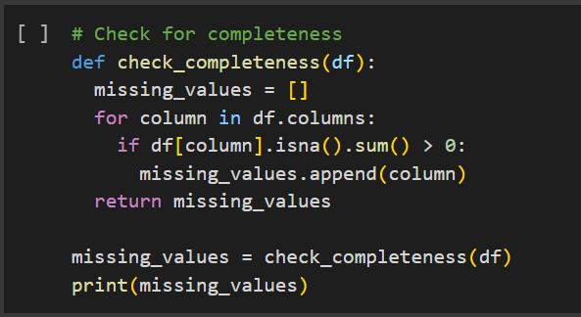
CLEANING DATA
We have cleaned the data to ensure that it is consistent and complete.

Slide 9
FINDING HYPOTHESIS PROBLEMS
Dissatisfaction with price
Dissatisfaction with product or service quality
Customer Satisfaction
Dissatisfaction with customer service
Dissatisfaction with billing or payment process
High customer lifetime value
Customer Value
High customer acquisition cost
High customer switching costs
Churn Risk
Presence of strong competitors
Competitive Landscape
Availability of attractive alternatives
Ease of switching to competitors
Age
Gender
Customer Demographics
Income
Location
Low usage levels
Customer Usage Patterns
Infrequent usage
Changing usage patterns

Slide 10
02
DATA ANALYSIS

Slide 11
Customer Status Overview
6.45%
67.02%
26.54%
New Joined Customers
Stayed Customers
Churned Customers
Notes:
Keeping the end user in mind (the board), I thought this approach of using summarised metrics had several benefits:
Focused on the key briefing points
Condensed a large number of variables i
Made it easy to digest, with no need to look at multiple charts and tables and try to relate and correlate.

Slide 12
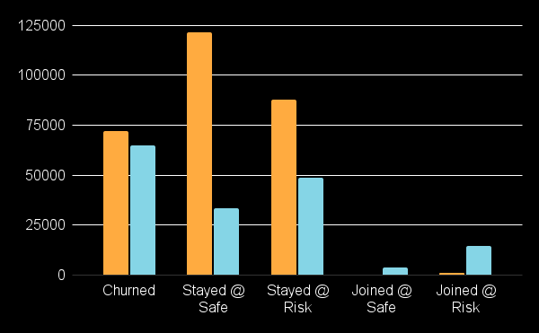
High Value & Low Value Total Monthly Charge
High Value
Low Value
The few new accounts that are not at risk appear to be low-value accounts.

Slide 13
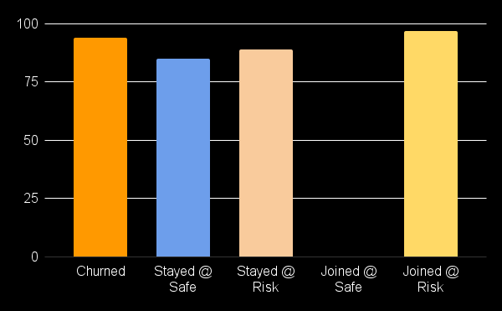
High Value AVG Total Monthly Charge
Churned accounts & Joined @ Risk have higher monthly charges than the total average, regardless of their value.

Slide 14
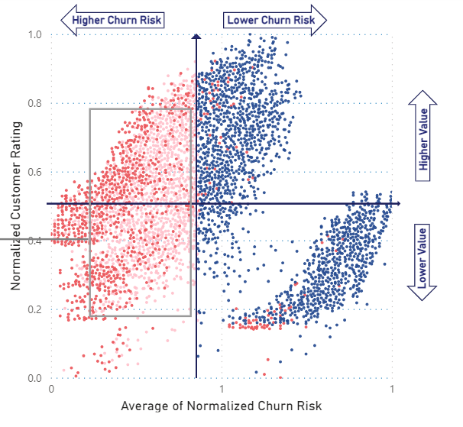
Splitting Churned, Stayed Customers
Further analysis shows that many high- and low-value customers who are still using the service have similar characteristics to churned accounts, and are therefore at risk of churning.

Slide 15
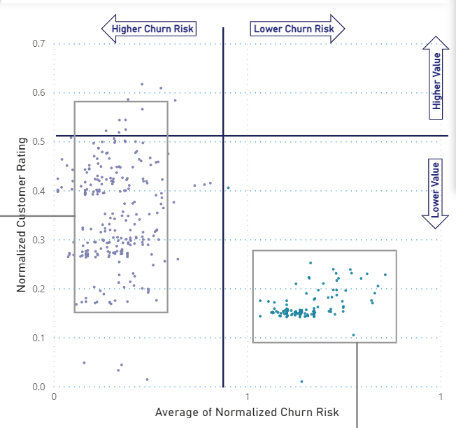
and Joined
Most new accounts also have similar characteristics to churned accounts, and are therefore at risk of churning.
The few new accounts that are not at risk appear to be low-value accounts.

Slide 16
THE TOP 10 CHURN CUSTOMER PROFILE CHARACTERISTICS
Key Churned Factors
Churn customer profiles typically show low-commitment, transitional customers with:
Month-to-month billing, limited add-ons, no offers, and fiber optic internet.
This lack of "stickiness" or incentive to stay is a major factor in churn.

Slide 17
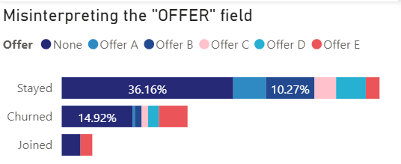
More Factor to Risk
Customers joined accepted Offer E or no offer at all.
But look at the Churned customer, customers with Offer E are likely to churn than others.

Slide 18
03
RECOMMENDATION

Slide 19
Key Recommendation
Offer incentives to move to a yearly contract or create a new quarterly contract.
Offer incentives to add additional services (security, streaming, etc.) by bundling them at reduced rates.
Examine issues associated with the Fiber Optic network to see if performance issues are resulting in poor customer experiences.
Offer E is an issue. Check again with Offer E. Postponing this offer or giving other offer instead.

Slide 20
01
02
03
SEGMENT
TARGET
SERVICES
Next Steps
Segment customers into different risk groups based on their customer satisfaction scores, usage patterns, and support interactions.
Target high-value customers with personalized discounts and promotions.
Offer churn-risk customers support and troubleshooting assistance.

Slide 21
Thank You For Listening!
Churn is a major challenge for telecom companies, but it can be mitigated through data-driven strategies. By identifying high-value customers, understanding churn risks, and implementing targeted retention initiatives, telecom companies can enhance customer satisfaction, boost loyalty, and drive long-term profitability.

